Slide 1






PREDICTING a 10 year risk of future Coronary Heart Disease (CHD)
SINDHURA SURAVARJHULA
MRUNALI SAROJ NILGIRWAR
UNDER GUIDANCE OF
DR. MEI YANG
-

Slide 2



ABSTRACT
Cardiovascular diseases and chronic respiratory diseases are a global threat.
Due to such high deaths, there is needed to tackle the reasons behind these diseases.
Most Coronary Heart Diseases can be prevented by addressing behavioral risk factors.
It is important to detect cardiovascular disease as early as possible so that management with counseling and medicines can begin.
Recent advances in the field of artificial intelligence and softwares have led to the emergence of expert systems for medical applications.
Moreover, in the last few decades computational tools have been designed to improve the experiences and abilities of expertss for making decisions about their patients.

Slide 3



OBJECTIVE
In this study we used R program with some packages.
Research intends to pinpoint the most relevant/risk factors of heart disease as well as predict the overall risk using classification models.
The objective of this project is to build a model which predicts if a patient is in risk of a coronary disease in the next ten years based on prevailing data available.

Slide 4




THE DATA
Got the dataset from kaggle.com
The dataset has 4239 rows and 16 columns.
The variables in the data set into three categories.
Demographics information about patient
Tobacco usage of patient
Health information of patient

Slide 5
THE DATA
Here, our Target Variable is “TenYearCHD”.
Indentifying data simpler:
Numerical Predictors -
Age, Cigs Per Day, Tot Chol, Sys BP, Dia BP, BMI, Heart Rate, Glucose
Categorical Predictors -
Education
Binary Predictors -
Sex, Current Smoker, BP Meds, Prevalent Stroke, Prevalent Hyp, Diabetes

Slide 6



NULL VALUES
BMI 19
Heart Rate 1
Glucose 388
Ten yr CHD 0
Sex 0
Age 0
Education 105
Current Smoker 0
Cigs per day 29
BP meds 53
Prevalent Stroke 0
Prevalent Hyp 0
Diabetes 0
Tot Chol 50
Sys BP 0
Dia BP 0

Slide 7
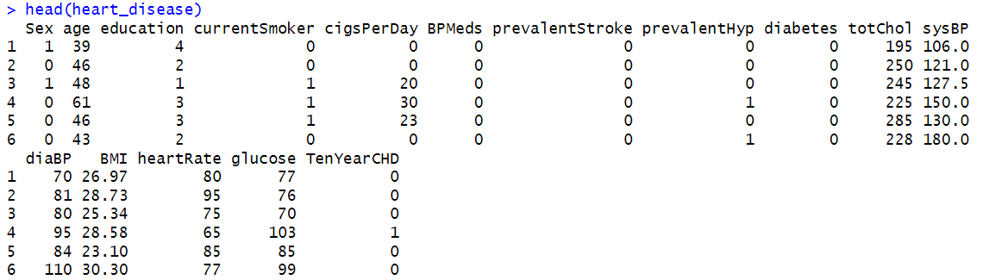
IMPUTATION
Mean Imputation

Slide 8



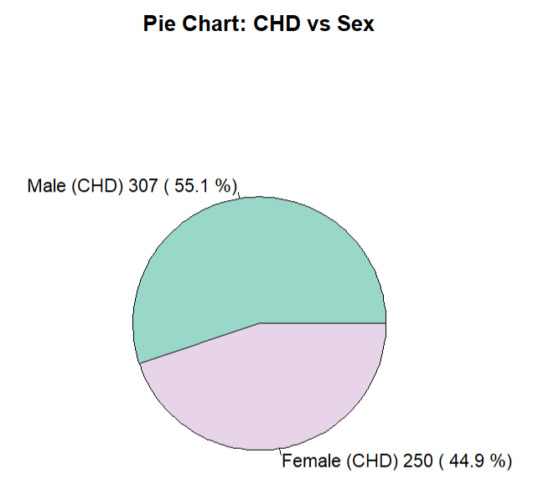
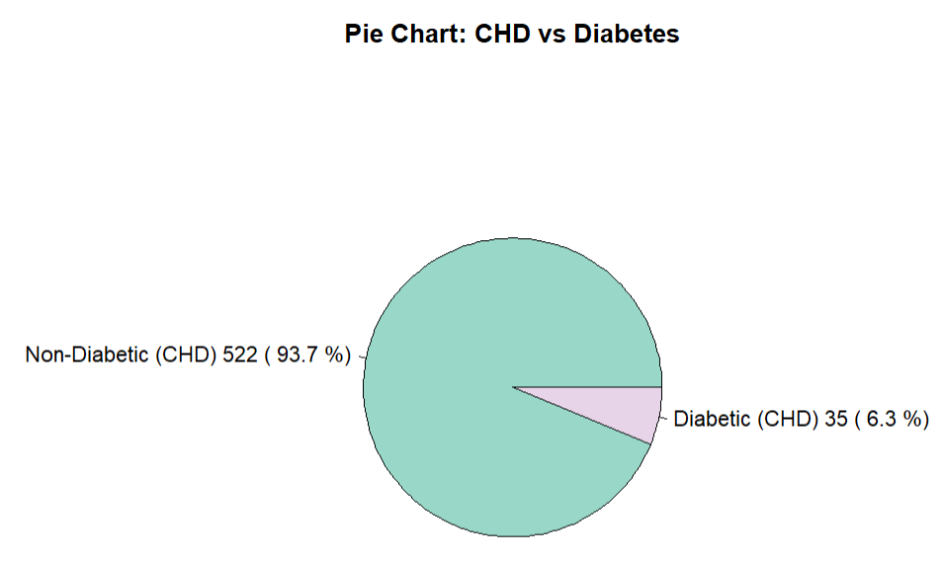
EDA / FEATURE ENGG.

Slide 9
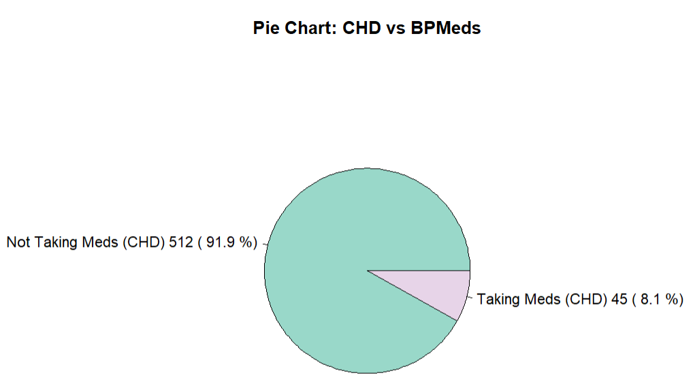
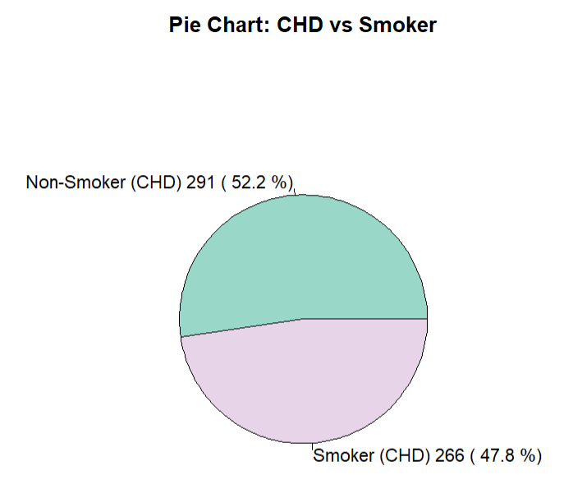
EDA / FEATURE ENGG.

Slide 10
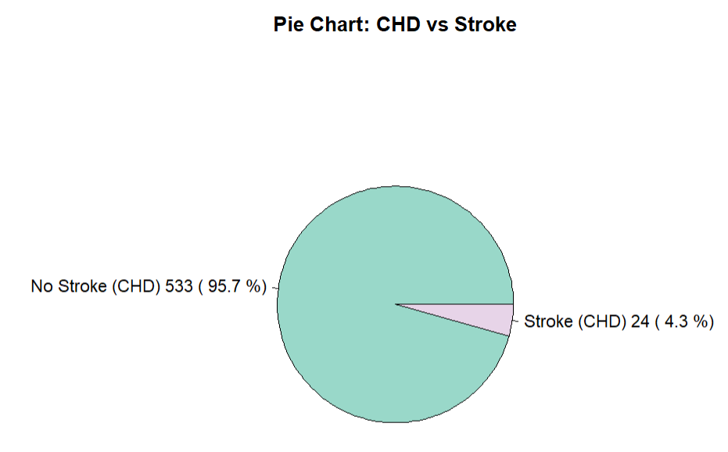
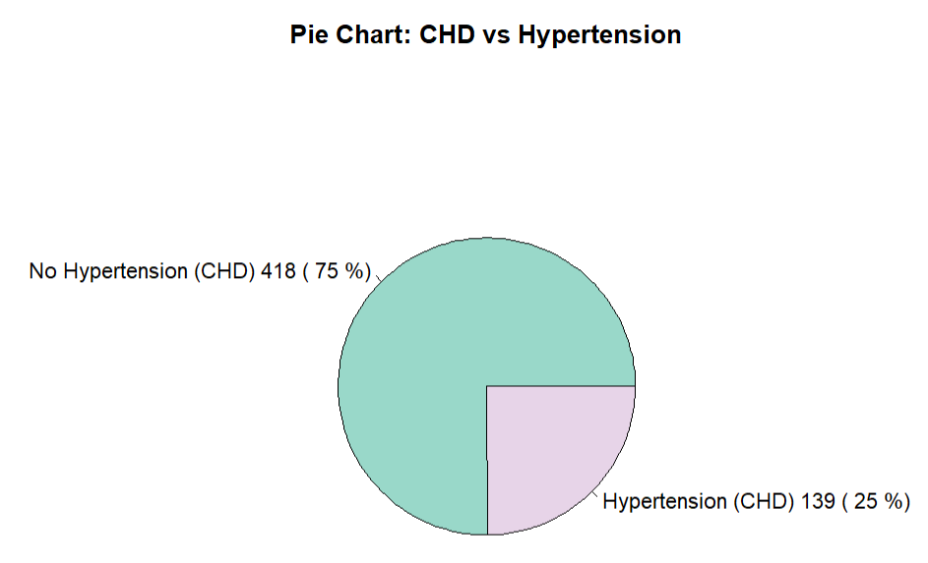
EDA / FEATURE ENGG.

Slide 11
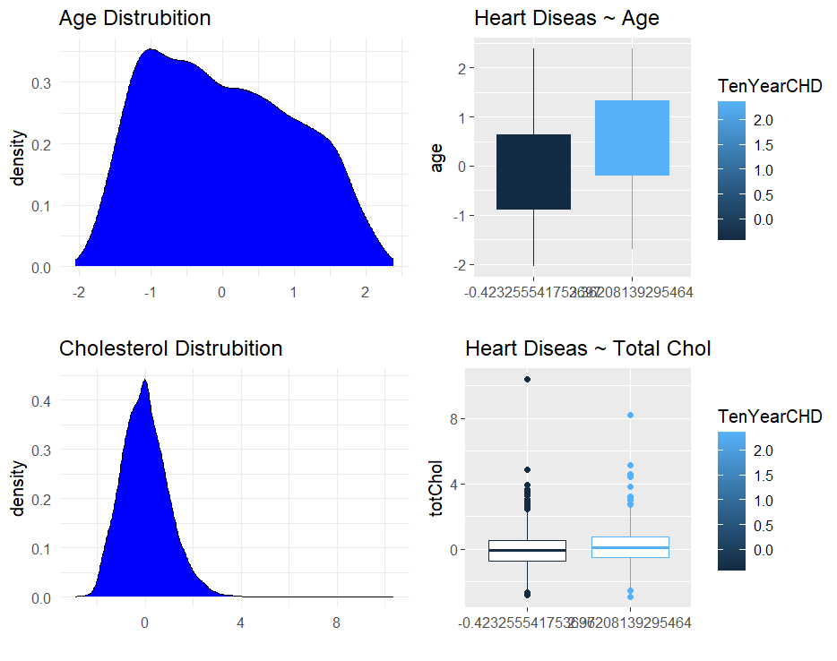
PLOTS
Age:
Older individuals have a higher risk of developing CHD, with CHD patients having a noticeably higher median age.
Age is a strong predictor of CHD.
Cholesterol:
Total cholesterol shows a slight increase in CHD patients but overlaps significantly with non-CHD patients, making it a moderate predictor.

Slide 12
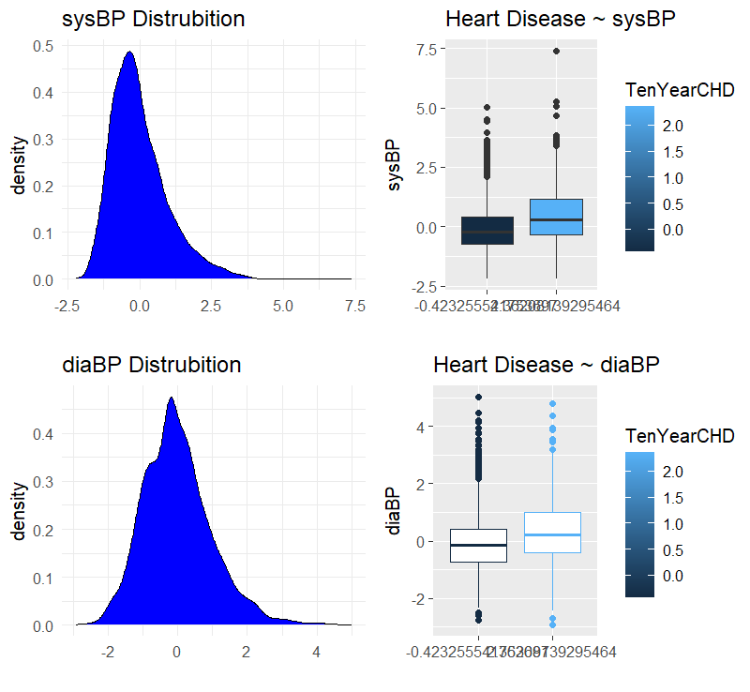
PLOTS
Systolic Blood Pressure (sysBP):
Higher systolic blood pressure is strongly associated with CHD, with CHD patients showing a higher median value.
Diastolic Blood Pressure (diaBP):
Diastolic blood pressure is higher in CHD patients but has less pronounced differences compared to systolic blood pressure.

Slide 13
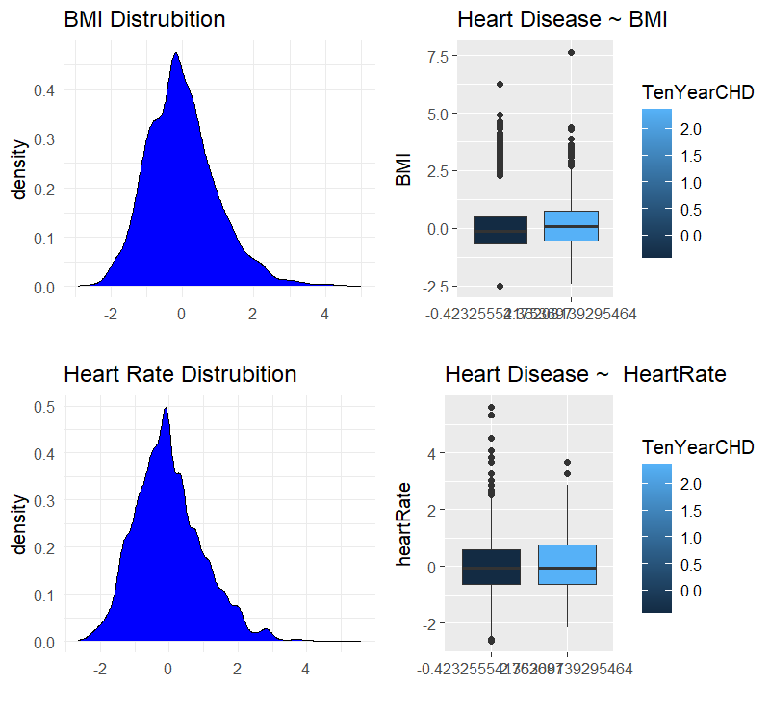
PLOTS
BMI:
Higher BMI is weakly associated with CHD, with a slightly higher median BMI observed in CHD patients.
Heart Rate:
No significant difference in heart rate is observed between CHD and non-CHD patients, making it a poor predictor.

Slide 14
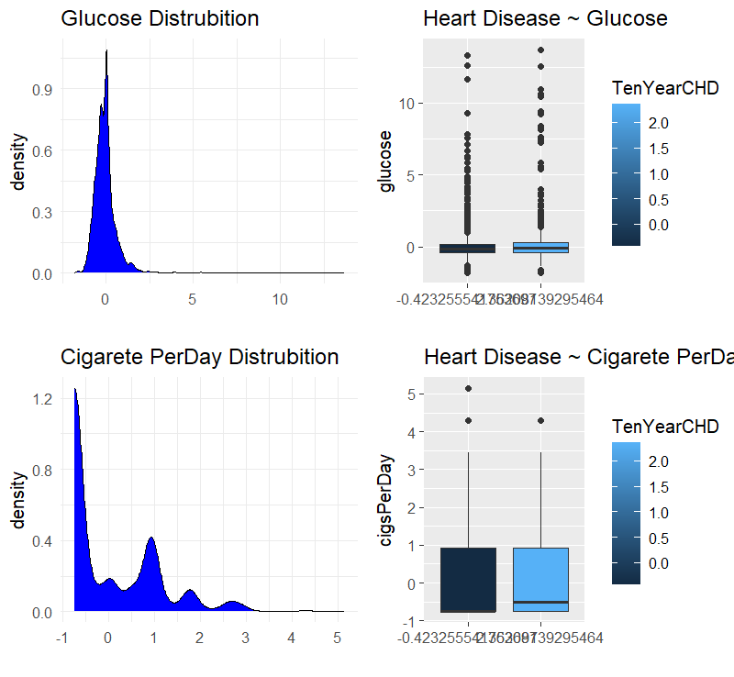
PLOTS
Glucose:
CHD patients have slightly higher glucose levels, but the difference is minimal, suggesting a weak association.
Cigarettes Per Day:
Smoking more cigarettes per day is moderately associated with CHD, with CHD patients showing slightly higher smoking habits.

Slide 15


CONCLUSIVE OBSERVATIONS
Strong Predictors of CHD:
Age, systolic blood pressure (sysBP)
-show clear differences between CHD and non-CHD groups.
Moderate Predictors:
Total cholesterol (totChol), Sex, Prevalent Strokes, BMI, and smoking habits (cigsPerDay)
-show some association with CHD.
Weak Predictors:
Heart rate, DiaBP and glucose levels
-show minimal differences between CHD and non-CHD groups.

Slide 16
ANOVA TEST ANALYSIS
Significant Predictors:
Age, Sex, SysBP, and Glucose show highly significant contributions to the model (p-values < 0.001), indicating strong relationships with the target variable, CHD risk.
Moderately Significant:
CigsPerDay has a moderate significance (p-value = 2.401e-05), while TotChol has borderline significance (p-value = 0.03273), suggesting some predictive value.
Model Insights:
Age contributes the most (highest reduction in residual deviance), followed by SysBP and Sex. These variables are critical in predicting the risk of CHD.

Slide 17
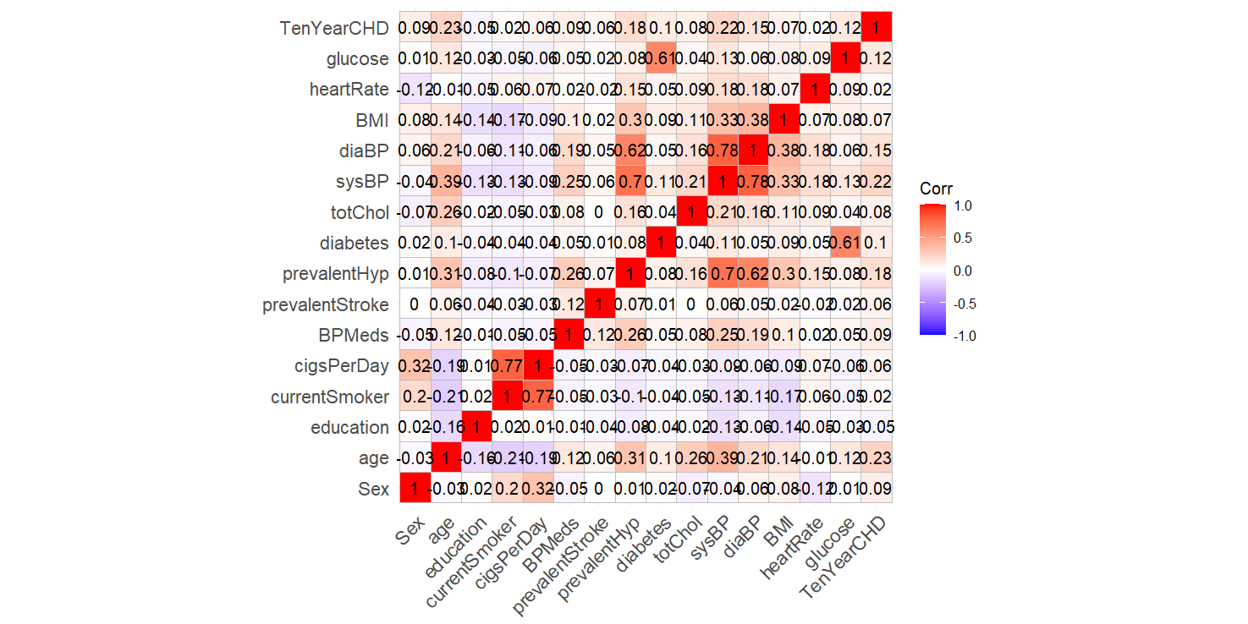
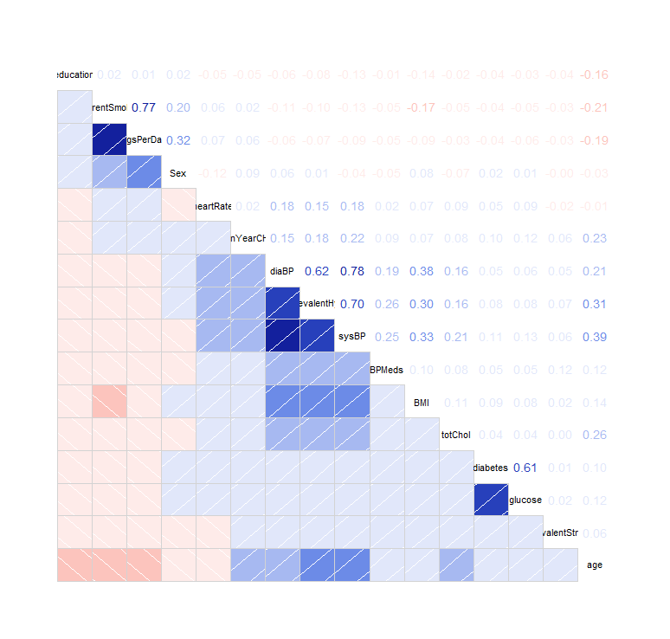
CORRELATION

Slide 18
HEATMAP CONCLUSION
Both plots suggest that:
sysBP, age, and prevalentHyp are the strongest predictors of CHD.
Multicollinearity exists between sysBP, diaBP, and prevalentHyp, which should be addressed in model building.
Other predictors like heartRate and education show minimal correlations and might not contribute significantly to the model.

Slide 19
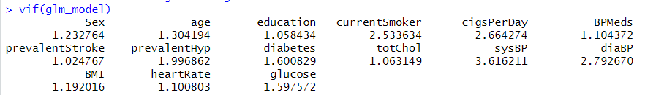
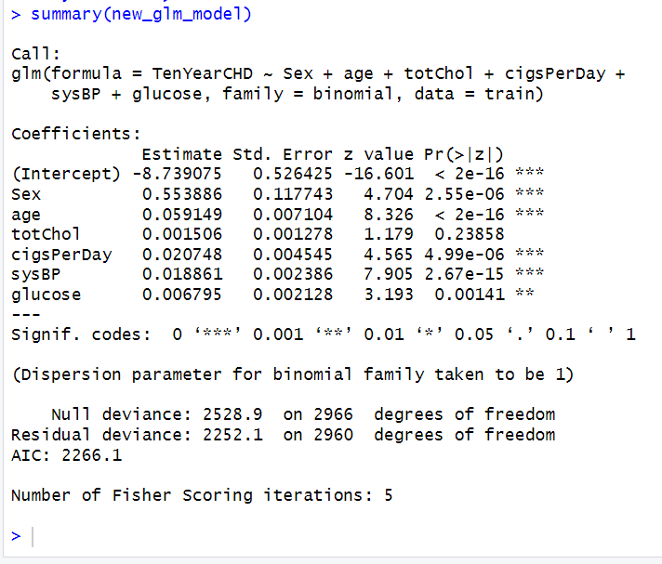
LOGISTIC REGRESSION
Model Fit:
R-squared: 0.1006 variability explained.
F-statistic: 254.7, p < 2.2e-16

Slide 20
LOGISTIC REGRESSION
Significant Predictors:
Sex: Strong predictor with a positive coefficient (0.703994). Men are at higher risk of TenYearCHD.
Age: Highly significant with a coefficient of 0.070944, indicating older age is strongly associated with increased heart disease risk.
sysBP: A positive coefficient (0.019054) shows that higher systolic blood pressure increases the risk.
Glucose: Positive coefficient (0.006159) reflects a significant but moderate contribution to heart disease risk.

Slide 21
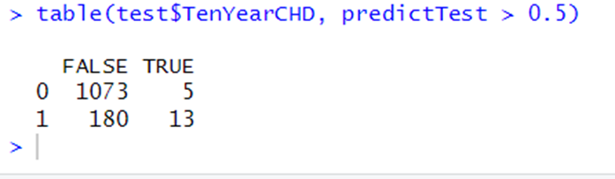
TEST SET PREDICTORS
CONFUSION MATRIX
Accuracy : 85.44 %
Precision (Positive Predictive Value): 72.22 %
Recall (Sensitivity): 6.74 %
Specificity (True Negative Rate): 99.54 %
F1-Score: 12.32 %
True Negatives (TN): 1073 (correctly predicted no CHD).
False Positives (FP): 5 (predicted CHD but no actual CHD).
False Negatives (FN): 180 (missed CHD cases).
True Positives (TP): 13 (correctly predicted CHD cases).

Slide 22
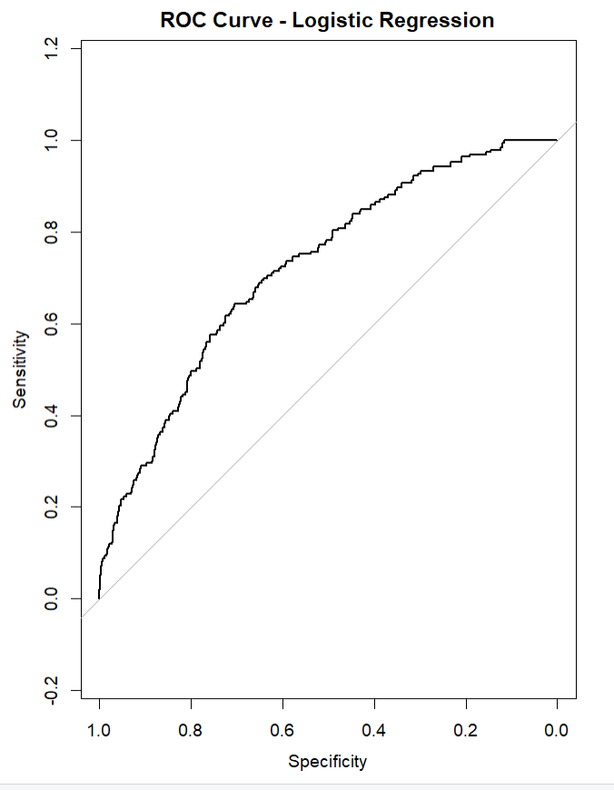
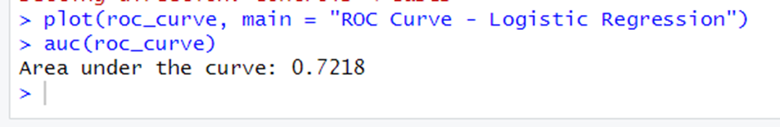
LOGISTIC REGRESSION
AUC (Area Under the Curve): 0.7218 (72.18%)
Indicates moderate predictive power.
Model Interpretation:
The model can distinguish between CHD and non-CHD cases 72.18% of the time.
Performs better than random guessing (AUC = 0.5).
Strengths:
ROC curve is above the diagonal, showing the model's ability to classify correctly.

Slide 23
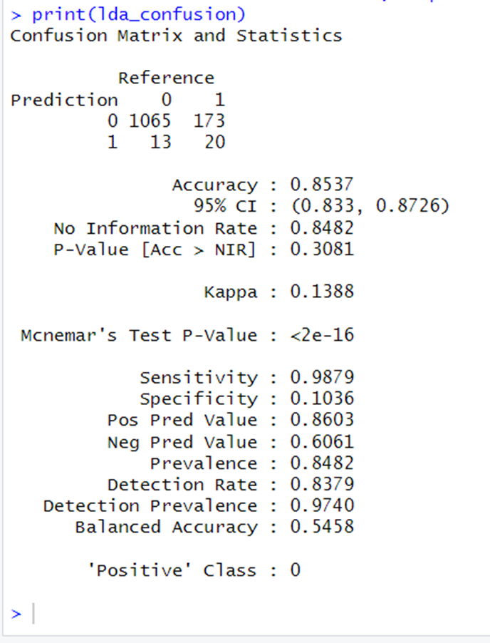
LDA
Model Fit:
R-squared: 0.497 variability explained.
F-statistic: 30.24, p < 2.2e-16
Strengths:
Excellent sensitivity; robust predictor identification.

Slide 24
LDA
Strong Predictors:
Age: Most significant with the highest coefficient (0.6225), indicating strong discrimination between classes.
Sex: Significant contributor with a coefficient of 0.5138.
SysBP (Systolic Blood Pressure): Contributes meaningfully with a coefficient of 0.2512.
Moderate Predictors:
CigsPerDay: Shows moderate impact with a coefficient of 0.2676.
Glucose: Moderate influence with a coefficient of 0.0088.
Weak Predictors:
Variables like TotChol, Education, and BMI have minimal impact based on low coefficients and may not strongly differentiate classes.

Slide 25
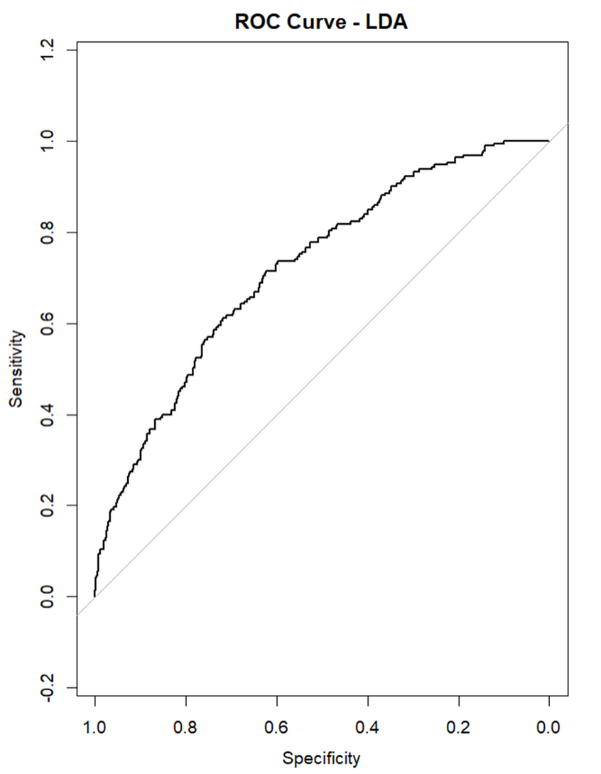
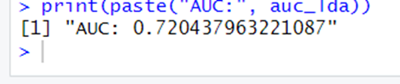
LDA
The ROC curve visualizes the trade-off between sensitivity (true positive rate) and specificity (false positive rate) for various threshold values in the LDA model.
A curve closer to the top-left corner represents a better model.
The AUC here (72%) reflects reasonably good discrimination power.

Slide 26
LRM - LDA
Logistic Regression:
Best for scenarios where avoiding false positives (non-CHD patients wrongly classified as CHD) is critical, as it has very high specificity.
LDA:
Best for detecting true CHD cases (high recall and sensitivity), useful in medical screening contexts where identifying potential CHD patients is critical.
-Both models achieve a similar overall accuracy
-Both models demonstrates moderate predictive power for classifying the risk of heart disease, with an AUC of 0.7204 for LDA and 0.7218 for LRM (showing slightly better discrimination).

Slide 27
RESULTS & DISCUSSIONS
The study cohort accumulated around 4000 patients-years of observation with 10 years.
The statistically independent predictive risk factors in our model are age, sex, totChol, cigsPerDay, sysBP, and glucose.
With every extra cigarette one smokes there is a 2% increase in the odds of CDH.
Smoking and aging are more effective on heart disease.
For Total cholesterol level and glucose level there is no significant change.
There is a 1.7% increase in odds for every unit increase in systolic Blood Pressure.

Slide 28
CONCLUSION
We have an accuracy about 85% on our test set, which means that the model can differentiate between low risk patients and high risk patients pretty well.
Men seem to be more susceptible to heart disease than women.
Increase in age leads to increased risk of having CHD for patients
The number of cigarettes smoked per day and systolic Blood Pressure also show increasing odds of having heart disease.
Total cholesterol shows no significant change in the odds of CHD. This could be due to the presence of 'good cholesterol (HDL) in the total cholesterol reading.
Glucose too causes a very negligible change in odds (0.2%).

Slide 29




Slide 30
CHALLENGES
Unbalanced Data:
•Our analysis aims to predict the risk of coronary heart disease using a dataset that presents a significant challenge.
•The dataset is imbalanced, with only 15% of individuals having a risk of coronary heart disease, while the remaining 85% have no such risk. This poses a challenge because standard machine learning models may be biased towards the majority class, leading to lower predictive performance for the minority class.
• Addressing this issue will require employing techniques such as data resampling or ensemble learning to improve the accuracy and robustness of our predictions.

Slide 31
IMPROVEMENTS
Improvements like balancing the dataset or exploring nonlinear models might help in better separation of the two groups.
Including ‘Exercise’ - whether the person exercises everyday
Environmental factors like AQI index of the city they live in could help derive more meaningful conclusions
Alcohol intake, and depression (mental health) factors are also essential conceptually and could have statistical influence on prediction

Slide 32

THANK YOU
QUESTIONS?

